Slide 1
AWS Virtual Learning Series (Day 1)
March 2022

Slide 2
Agenda
Day 1 - 28 March
ETL Intro 18:00 - 18:30
ETL Demo 18:30 - 20:00
EMR Intro 20:00 - 20:30
EMR Demo 20:30 - 21:00

Slide 3
Introduction to ETL at AWS
Presented by Samkelo Maneli, ETL Cloud Engineer

Slide 4
Data Movement/Migration
Generally data movement comes from a Raw Data environment into a Cleansed Data Environment.
Let us look into these respective Data Environments
Notes:
Many organizations face challenges maintaining and managing the security of their on-premises infrastructure. Why?
Lack of visibility
In an on-premises environment, it can be difficult to know what resources and data are out there at any given time, where it is moving, and who is utilizing / accessing it.
For example, it requires expensive/complex tooling to get an accurate, real-time asset inventory.
Most organizations just don’t have the level of visibility that they would like in an on-premises environment. And, without visibility, it is challenging for organizations to adequately secure their infrastructure and their data to meet their security and compliance requirements.
Low degree of automation
Another typical challenge is trying to get rid of the manual processes employed to remediate issues. Think copying and pasting information from one tool to another, or manually applying patches. It’s been difficult to automate key security tasks due to issues, such as the interoperability of the third-party and home grown tools.
Manual processes tend to lead to inconsistent execution, longer wait times to address all systems, and in most cases disrupts the customer experience. So, the goal of automation is to programmatically handle tasks that would otherwise be done manually by IT staff. This is much easier in the Cloud as we will see.
This combination of lack of visibility into their own environment coupled with a low degree of automation compromises an organization’s ability to move quickly and effectively secure their on-premises infrastructure.

Slide 5
Data Environments in the cloud
We are looking to retain and make use of all the data we have, unstructured or structured.
As we can imagine this data gets messy and will need to be cleansed.
Data Lake
In a Data Warehousing environment, the data that we are bringing in already has some structure in it and is normalized.
Data Warehouse
AWS

Slide 6
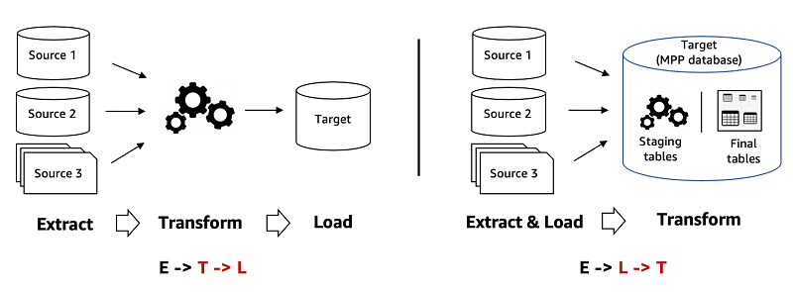
ETL vs ELT
To conduct the migration/s needed above we have 2 approaches: ETL and ELT

Slide 7
What is ETL?
Extract: Read what we need from the Source Store/s
Transform: Cleanse/Wrangle the source data into the shape and/or format that we would like it be
Load: Write out the transformed data into a Target Store. Generally from multiple sources (such as a raw Data Lake environment, JDBC stores, etc) into a Data Warehousing environment where business insights are generated

Slide 8
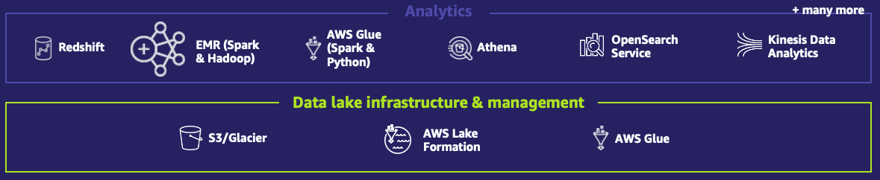
ETL Offerings at AWS
AWS Glue
Data Pipeline
AWS Lake Formation
Amazon Athena
Managed Workflows for Apache Airflow
AWS Glue DataBrew

Slide 9




AWS Glue
Crawler: infers data source metadata such as schema, partitions, etc. and then based on this metadata creates a Data Catalog table
ETL engine: we have options either based on Vanilla Python (called the Python Shell) or Open Source Apache Spark for ETL transformations
1. Download data into Amazon S3
2. Schedule jobs to clean and transform data
Amazon S3
AWS Glue

Slide 10
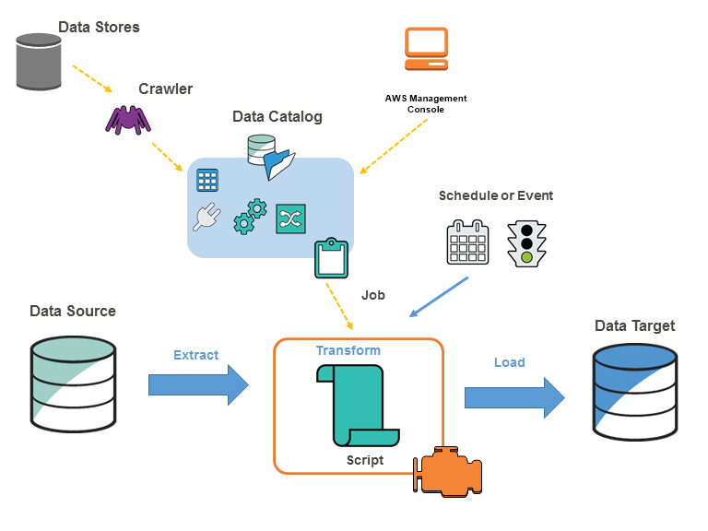
Glue Cont.
Data Catalog: A metadata store that holds metadata tables and databases. These tables can either be created and/or updated by the crawler or we could create and/or update them manually
Workflows are a Glue proprietary feature that allows for orchestration of Glue components such as the ETL job, crawlers, etc

Slide 11

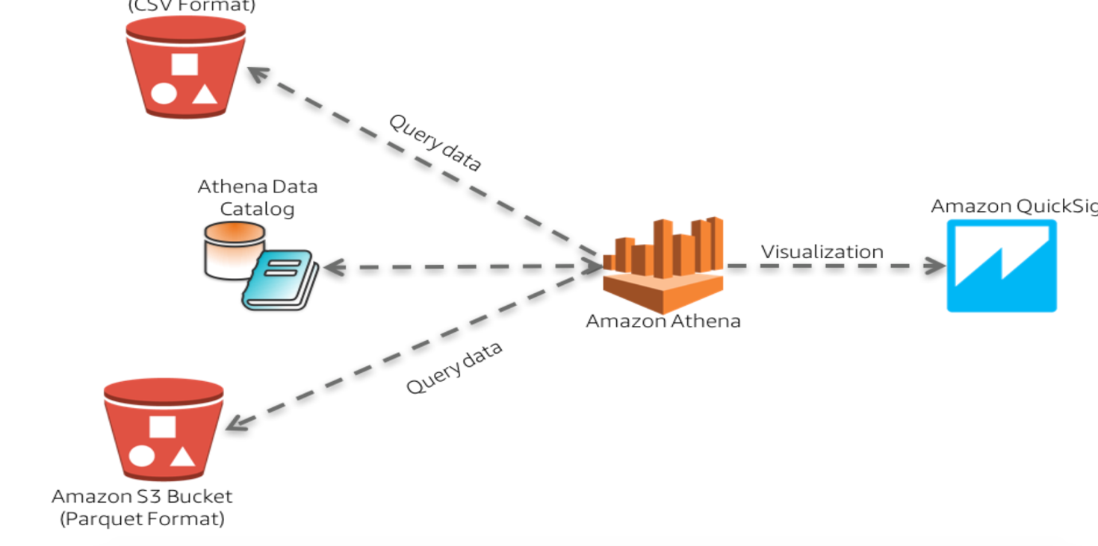
Amazon Athena
A SQL query tool based on open source Presto for DML queries and Hive for DDL queries
Federated queries have also provided us the ability to use AWS-provided connectors or make use of our own Custom Presto Connectors using Lambda

Slide 12
AWS Data Pipeline
Serves purely for ETL purposes just like Glue but unlike Glue lacks the Developer experience and provides more of a basic ETL functionality .i.e more drag and drop interface with little code involved
The benefit from Glue is that we have more flexibility to the operations we have such as the CLI activity whereas with Glue we are limited to either Python or Scala for our ETL migration.
Data Pipeline also has Change Data Capture capabilities which is more JDBC friendly than Glue Job Bookmarks

Slide 13
Managed Workflows for Apache Airflow
This offering is a managed version of the Open Source Software Apache Airflow.
We have not adapted this in any way. MWAA was meant to assist Data Engineers/Data Scientist with the ability to conduct their workload orchestration without the need to setup an airflow Environment
We define the Workflow tasks as a Directed Acyclic Graph

Slide 14
AWS Lake Formation
- The administrative layer for our Data Lake ecosystem
Lake Formation’s most popular feature allows us to be able to manage our Data Catalog metadata as well as the data for the underlying s3 location.
Another up and coming Lake Formation feature is the newly-GA Governed Tables, which allow our S3 data lake location to have ACID properties so that each data lake user can have their own consistent view of the source data

Slide 15
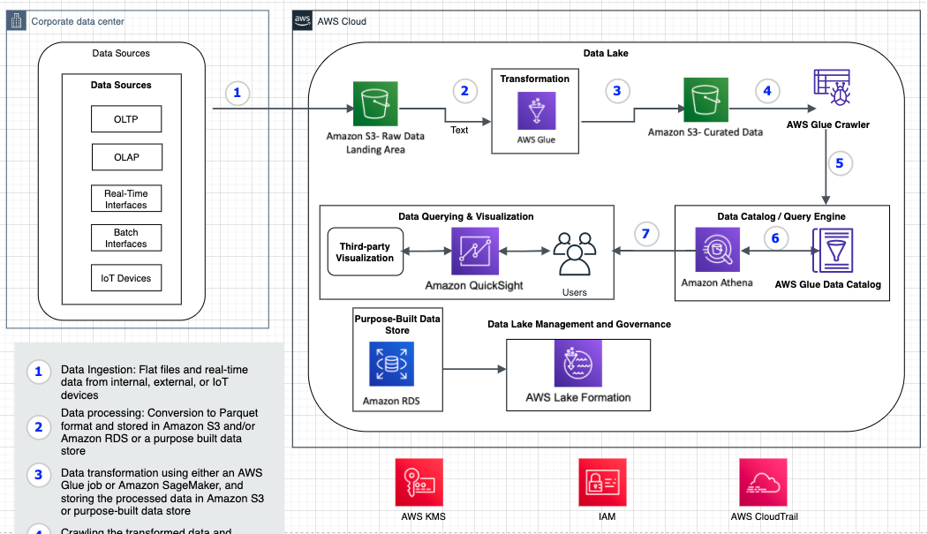
Data Lake Scenario

Slide 16
Q & A

Slide 17
Thank You!

Slide 18
ETL Demo Using Glue Databrew
Presented by Adedolapo Oluwabukunola Akin-Adetoro, ETL Cloud Engineer

Slide 19
Table of Contents
Aim of the ETL Demo Session
What is AWS Glue Data Brew
Core concepts of AWS Glue Data Brew
ETL Demo

Slide 20
Aim of the ETL Demo Session
The aim of this ETL Demo Session is give you hands on exposure to AWS Glue DataBrew.
We will cover the following topics
What is AWS Glue DataBrew?
Core concepts and terms in AWS Glue DataBrew
ETL Demo using AWS Glue DataBrew

Slide 21
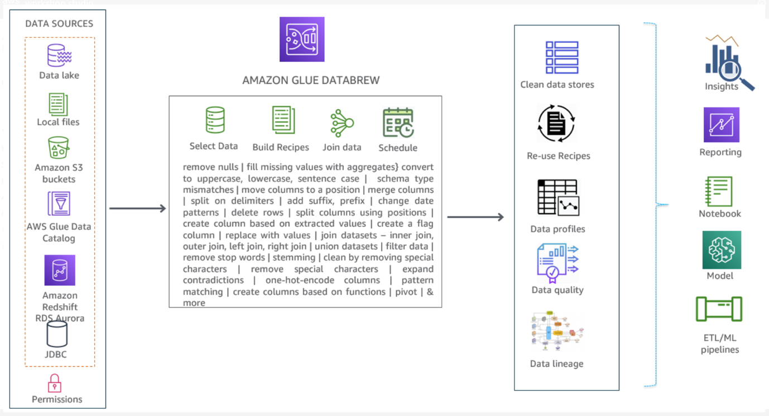
What is AWS Glue Data Brew
AWS Glue DataBrew is a visual data preparation tool that makes it easy for data analysts and data scientists to prepare data with an interactive, point-and-click visual interface without writing code.

Slide 22

Poll
What is the difference between ETL and ELT?

Slide 23
Core concepts of Glue Data Brew
Dataset
For DataBrew, a dataset is a read-only connection to your data. DataBrew collects a set of descriptive metadata to refer to the data. No actual data can be altered or stored by DataBrew .
Project
The interactive data preparation workspace in DataBrew is called a project. Using a data project, you manage a collection of related items: data, transformations, and scheduled processes.
Recipe
In DataBrew, a recipe is a set of instructions or steps for data that you want DataBrew to act on. A recipe can contain many steps, and each step can contain many actions. You can download and reuse recipes in other projects.

Slide 24
Core concepts
Job
DataBrew takes on the job of transforming your data by running the instructions that you set up when you made a recipe. The process of running these instructions is called a job
Data lineage
DataBrew tracks your data in a visual interface to determine its origin, called a data lineage. This view shows you how the data flows through different entities from where it originally came, what happened to it over time, and where it was stored.

Slide 25
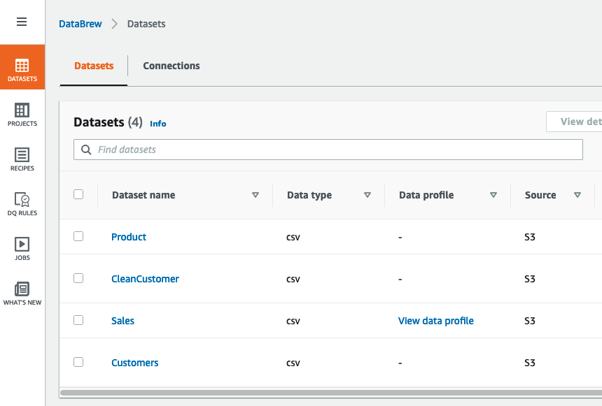
Core concepts

Slide 26
ETL Demo- Business case
Company ABC is a online pet product retailer that has recently launched a new product line for pet. Sales for the new product line is struggling in some regions
Their market research shows that the poor sales is due to limited product awareness in the affected region. To address the sales problem, they need to start a targeted mail campaign in the affected region to increase awareness.
The team needs a fast turn around and they don’t have much time to write code and manage infrastructure.
Actions: The team needs to analyse and transform customer, product, and sales data to compare and contrast sales of two product lines and identify zip codes where specific product types need to be marketed.

Slide 27

Poll
What is a Bridge Table?

Slide 28
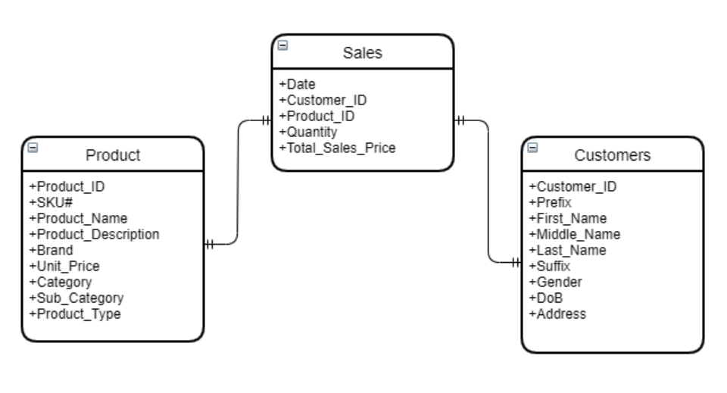
ETL Demo- Data Model

Slide 29
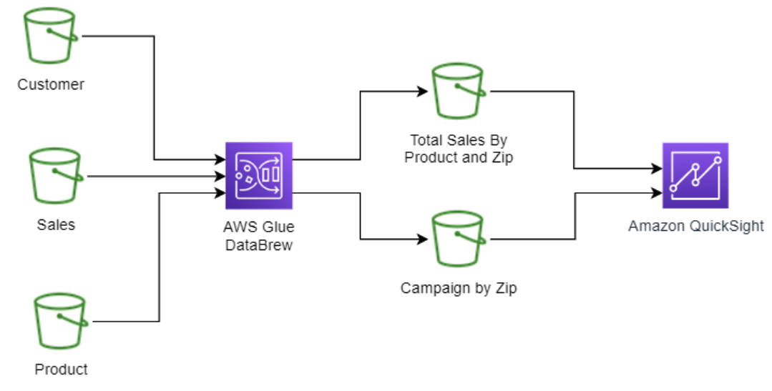
ETL Demo- Logical Data Flow

Slide 30
ETL Demo- Data transformation steps
Clean the customer data and parse the zip code from the address column
Join sales data with customer data and product data to compare sales by zip and product type
Finally generate lists of zip codes with marketable product IDs.

Slide 31
Poll
Does AWS Glue Databrew store the actual dataset?

Slide 32
Intro to Amazon EMR (Elastic Map Reduce)
Presented by Fhumulani Nemulodi, EMR Cloud Engineer

Slide 33
Table of contents
What is EMR?
EMR Architecture (Hadoop)
HDFS as a file system
YARN
MapReduce
Benefits of using EMR
EMR use Cases

Slide 34
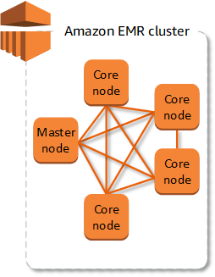
What is Amazon EMR?
Provides a managed Hadoop framework that quickly & cost-effectively process vast amounts of data
Makes it easy, fast & cost-effective for one to process data
Run several popular distributed framework such as Spark

Slide 35
EMR (Hadoop) Architecture
EMR implements managed Hadoop platform to distribute and process vast amounts of data across dynamically scalable Amazon EC2 instances.
Hadoop is an open source frame work that is used to store, process, and analyse chunks of data.
EMR provides easy deployment when compared to on premise clusters.

Slide 36

Hadoop on EMR
HDFS
Yarn (Yet another resource negotiator) for cluster management
MapReduce for data processing
YARN RM
NameNode

Slide 37
Hadoop core components: HDFS
A distributed file system that runs on commodity hardware used for managing and storing data.
Consists of two components namely, name node, and data node.

Slide 38
Hadoop core components: HDFS
How HDFS Stores Files in Blocks
Actor writes a 1GB files to HDFS
The file is broken into blocks of 128MB
These blocks are distributed across all Data Nodes
Replication factor is also important

Slide 39
Hadoop core components: HDFS
How A Read/Write is Handled in HDFS
Client requests file system metadata.
NameNode sends Client the metadata, which includes a list of relevant Data nodes where the data lives.
Client application now communicates directly with the DataNodes to read/write data

Slide 40
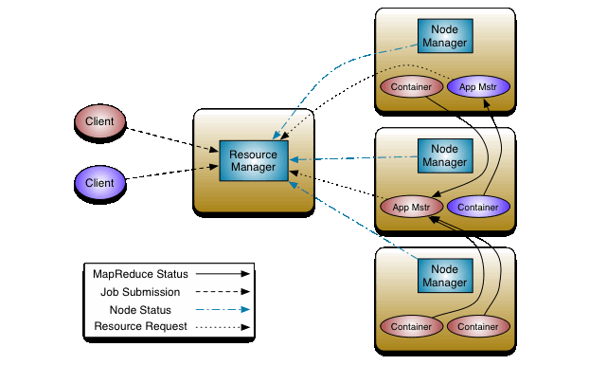
Hadoop core components: YARN
Apache YARN (Yet Another Resource Negotiator) is a resource management.
It makes use of the components namely, resource manager, node manager, application master and containers for job scheduling, processing of activities by allocating resources and scheduling tasks.

Slide 41
Hadoop core components: MapReduce
MapReduce is a framework used for processing huge amounts of data.
It works in two phases, namely, Map and Reduce
For an example MapReduce word count job processes:
Input split (Divide input file)
Mapping (count occurrence)
Shuffling (Group same words together)
Reducing (complete the counting

Slide 42
Benefits of using EMR
Flexible
Low Cost
Secure
Amazon EMR
Elastic
Easy to Use

Slide 43

Benefits of using EMR
Compute Flexibility
General Purpose
Compute Intensive
Memory Intensive
Storage Intensive
M5 Family
M4 Family
M6g Family
C5 Family
C4 Family
C6g Family
X1 Family
R4 Family
R6g Family
D2 Family
I3 Family
Batch Process
Machine Learning
Interactive Analysis
Large HDFS

Slide 44


Leverage Amazon S3 as your persistent data store with EMR File System (EMRFS)
Benefits of using EMR
Support big data frameworks natively (Spark, Hive, Presto, etc.)
Decouple storage and compute
No need to run compute clusters for storage (unlike HDFS)
Can run transient Amazon EMR clusters with Amazon EC2 Spot Instances
Multiple & heterogeneous analysis clusters and services can use the same data
Deliver 99.999999999% durability for stored data
Avoid extraneous data replication cost
Long running Cluster
(Spark-SQL | Presto)
Transient Cluster
(X hours nightly)
Amazon S3
External Metastore
Workload specific clusters
(Different sizes, Different Versions)

Slide 45











Integration with AWS services
Benefits of using EMR
S3 via EMRFS
EBS support for scaling HDFS
Streaming data access to both Amazon Kinesis and Amazon MSK
Amazon KMS for encryption key management
Map Amazon DynamoDB tables with DynamoDB- connector for Hive
Connect to Amazon Redshift through redshift-spark connector
Wrap Amazon EMR cluster with IAM roles for access policies
AWS Glue
AWS Lake Formation

Slide 46

Benefits of using EMR
Secure (authentication)
LDAP
HiveServer2
Presto Coordinator
Spark Thrift Server
Hue Server
Zeppelin Server
EC2 key pair
SSH as “hadoop”
AWS credentials
EMR Step (EMR API)

Slide 47
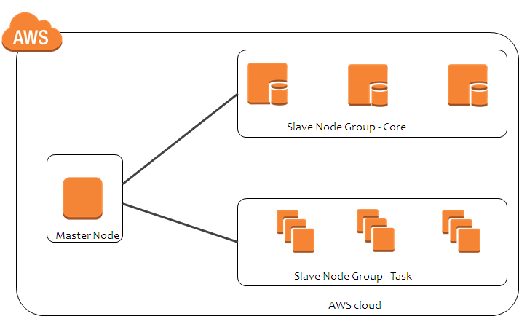
Benefits of using EMR
Completely managed environment for automatically resizing clusters
No configurations required except min/max cost constraints
Can save 20-60% costs depending on the workload pattern
High Resolution Metrics enabled with Managed scaling
Use autoscaling for DIY scaling with custom metrics
Managed scaling for completely managed option
Permanent Nodes
Transient nodes

Slide 48
Lowest Cost
Benefits of using EMR
Less admin time to manage, and support Hadoop clusters
No up-front costs—hardware acquisition, installation
Save on operating costs—data center space, power, cooling
Business Value: Cost of delays, Risk Premium, Competitive abilities, governance, etc.
On-premises
EMR
Support Costs
Subscription Fee
Support Costs
Server Costs
Hardware—Server, Rack, Chassis, PDUs, Tor Switches (+Maintenance)
Software—OS, Virtualization Licenses (+Maintenance)
Network Costs
Network Hardware—LAN Switches, Load Balancer Bandwidth costs
Software—Network Monitoring
IT Labor Costs
Server admin, virtualization admin, storage admin, network admin, support team
Extras
Project planning, advisors, legal, contractors, managed services, training, cost of capital

Slide 49
EMR use Cases
Finance
Security and Law
Government
Retail
Sentiment Analysis
Understanding Customers
Healthcare
Advertisement

Slide 50
EMR use Cases
1. Machine Learning
EMR provides built-in machine learning tools for scalable machine learning algorithms like TensorFLow, Apache Spark MLib, and Apache MXNet. Also you can easily use Bootstrap Actions and Custom AMIs for easily adding the preferred tools and libraries for creating your very own predictive analytics toolset.
2. Extract Transform Load (ETL)
For cost-effective and quick performance of data transformation workloads (ETL) like sort, join and aggregate on large datasets, you can use EMR

Slide 51
EMR use Cases
3. Clickstream analysis
With EMR, along with Apache Hive and Apache Spark, you can segment users, deliver effective ads by understanding the user preferences. All this can be achieved by analyzing the clickstream data from Amazon S3.
4. Real-time streaming
With EMR and Amazon Spark Streaming, analyzing events from Amazon Kinesis, Amazon Kafka or any other streaming data source is possible. This helps in creating highly available, long running, and fault-tolerant streaming data pipelines. Persist transformed insights to Amazon Elasticsearch and datasets to HDFS or Amazon S3.

Slide 52
EMR use Cases
5. Interactive Analytics
With EMR Notebooks, you will be provided with an open-source Jupyter based, managed analytic environment. This will allow data analysts, developers and scientists in preparing and visualizing data, collaborating with peers, building applications, and performing interactive analysis.

Slide 53
Q & A

Slide 54
Thank You!

Slide 55
Introduction to EMR using pyspark
Presented by Wandile Mthethwa, EMR Cloud Engineer

Slide 56
Focus Point
Apache Hive
Hadoop (HDFS)
Yarn Resource Allocation(YARN)
Spark
Jupyter Notebook Attached to EMR
EMR Managed Scaling

Slide 57
Aim of the EMR Demo Session
Purpose of this demo session is to show how pyspark process data on EMR
Create EMR cluster 6.4 version
Create Jupyter Notebook
Allocate Resource to pyspark Job
Analyze and transform data using pyspark
Save transformed data on Hadoop as hive tables

Slide 58
Poll
What is the primary purpose of EMR?

Slide 59
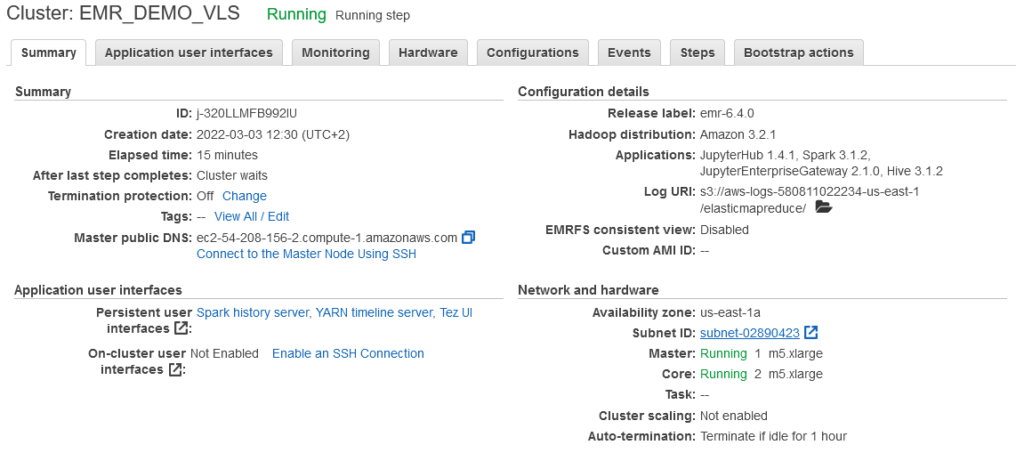
EMR Demo Specification:
EMR 6.4.0
JupyterHub 1.4.1
Spark 3.1.2
JupyterEnterpriseGateway 2.1.0
Hive 3.1.2

Slide 60
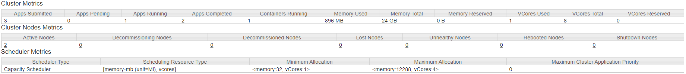
EMR Demo Specification Node Resource:
Core Node:
2 CoreNodes = 8 VCore Total
2 Corenodes = 32 GB Memory – 8GB for Overhead and OS process = 24 GB
m5.xlarge | 4 | 16 | EBS-Only | Up to 10 | Up to 4,750

Slide 61
Poll
How does EMR node scaling help?

Slide 62
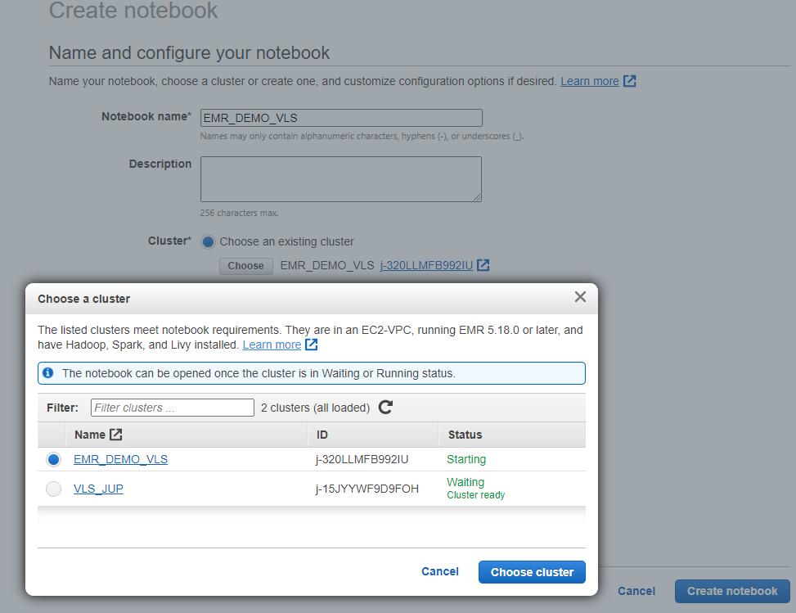
Create Notebook and Attach to Cluster:

Slide 63
EMR Hands-On Demo
Create a spark Session with desired resources on Jupyter
Two census dataset will be used.
We will Analyze and transform the data.
Write the analyzed data as hive tables.

Slide 64
Poll
Does EMR store data?

Slide 65
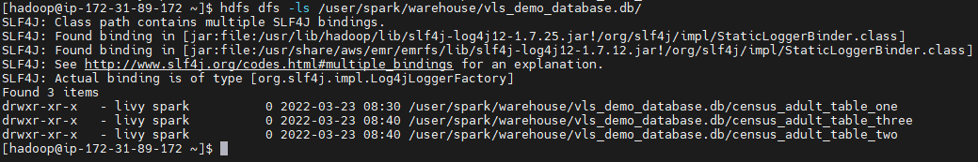
Hadoop data location.

Slide 66
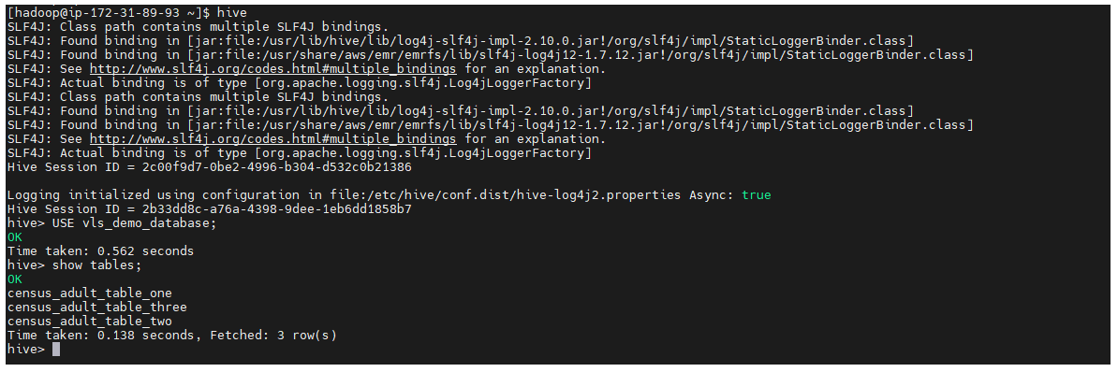
Hive Table

Slide 67
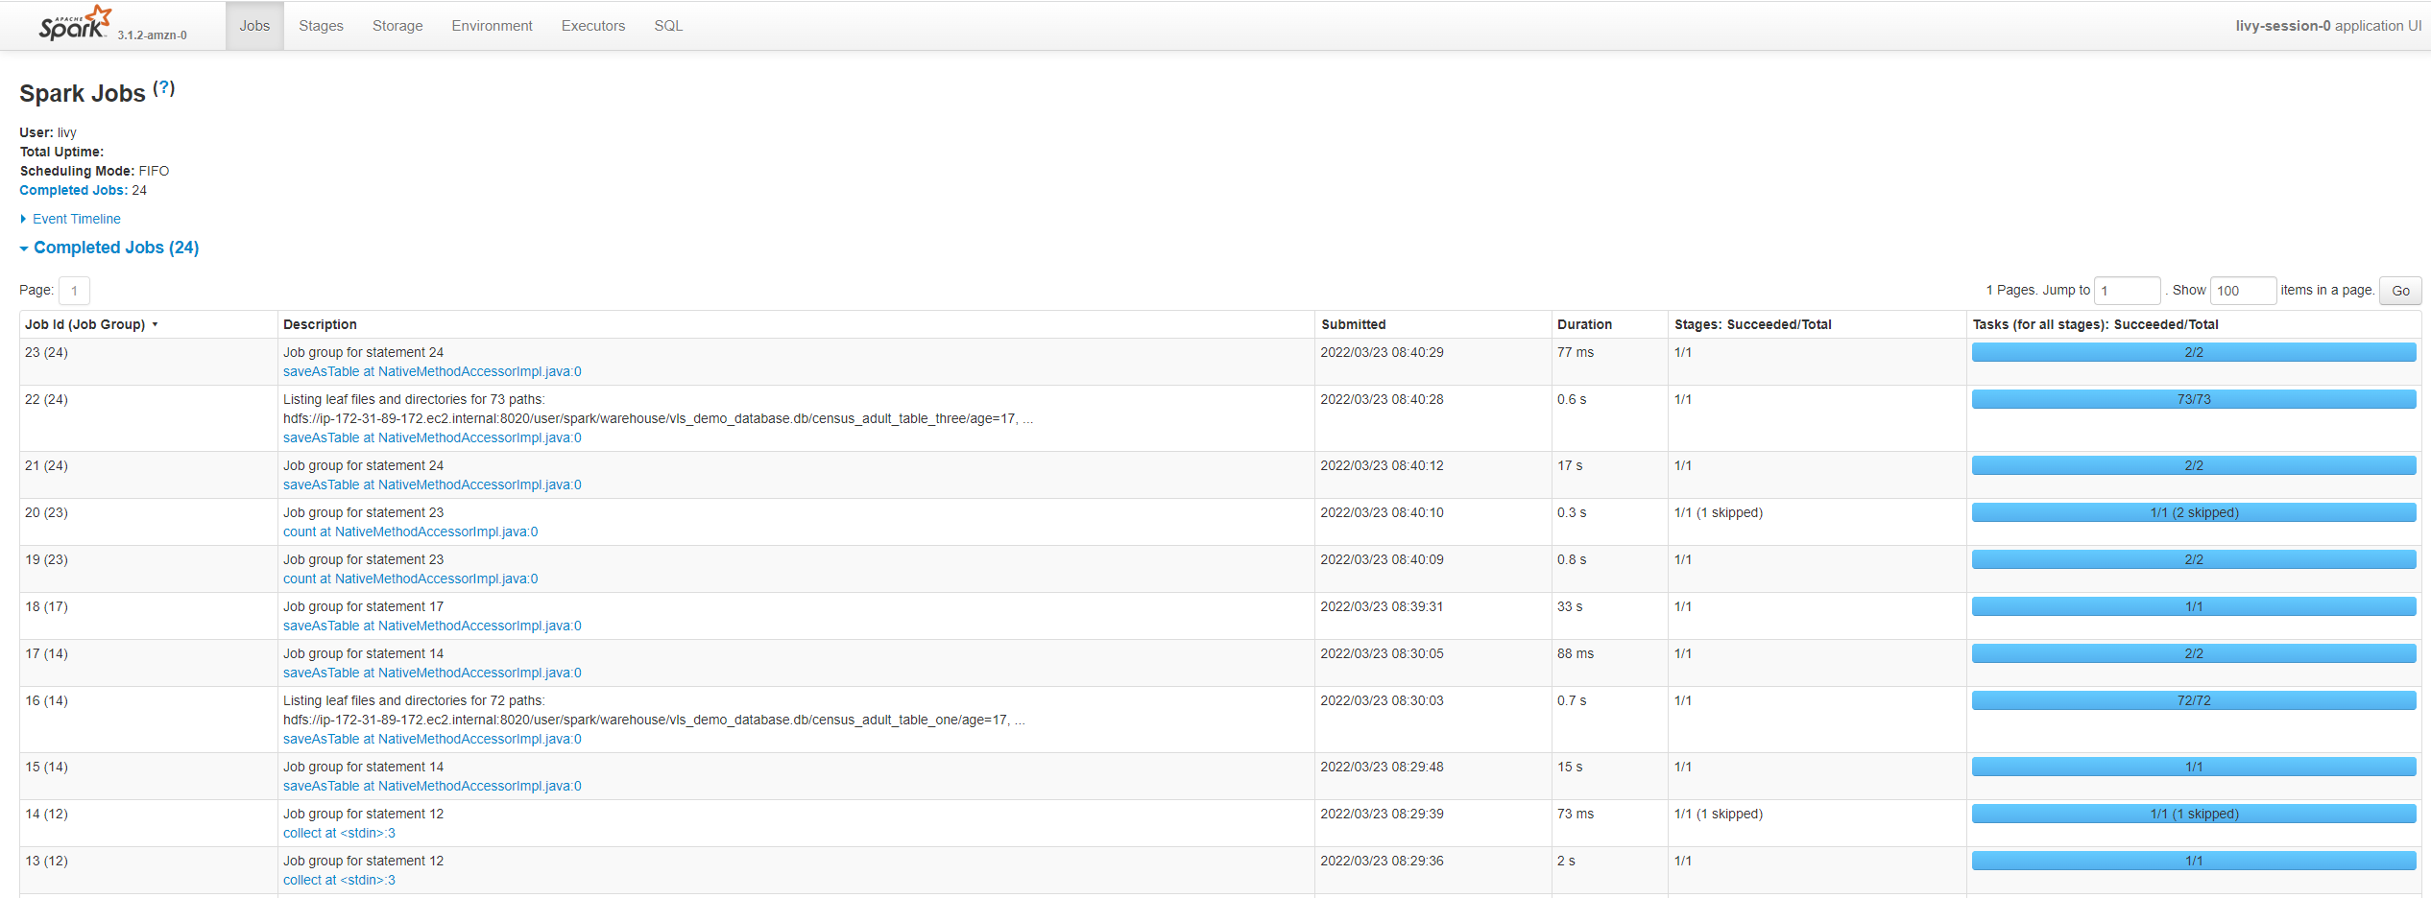
Spark History Server.

Slide 68
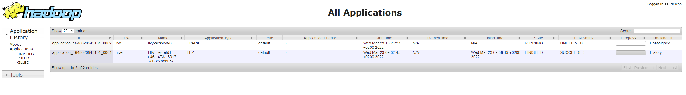
YARN timeline Server

